Slide 1
Digital Pet Task App
Team Members: Sarah Jorissen, Laura Lopez, Jonathon Hoffman

Slide 2
What Will Be Covered
Block Diagram
Component Diagram
User Interface Storyboard
Storage Documentation

Slide 3
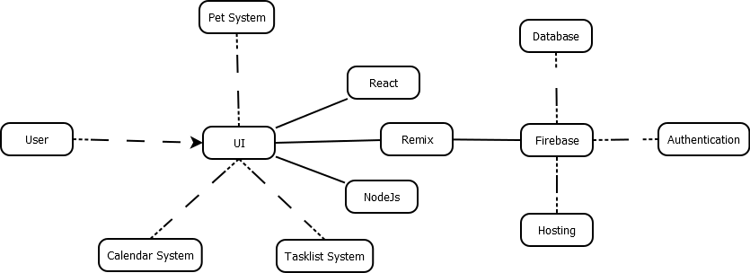
Block Diagram

Slide 4
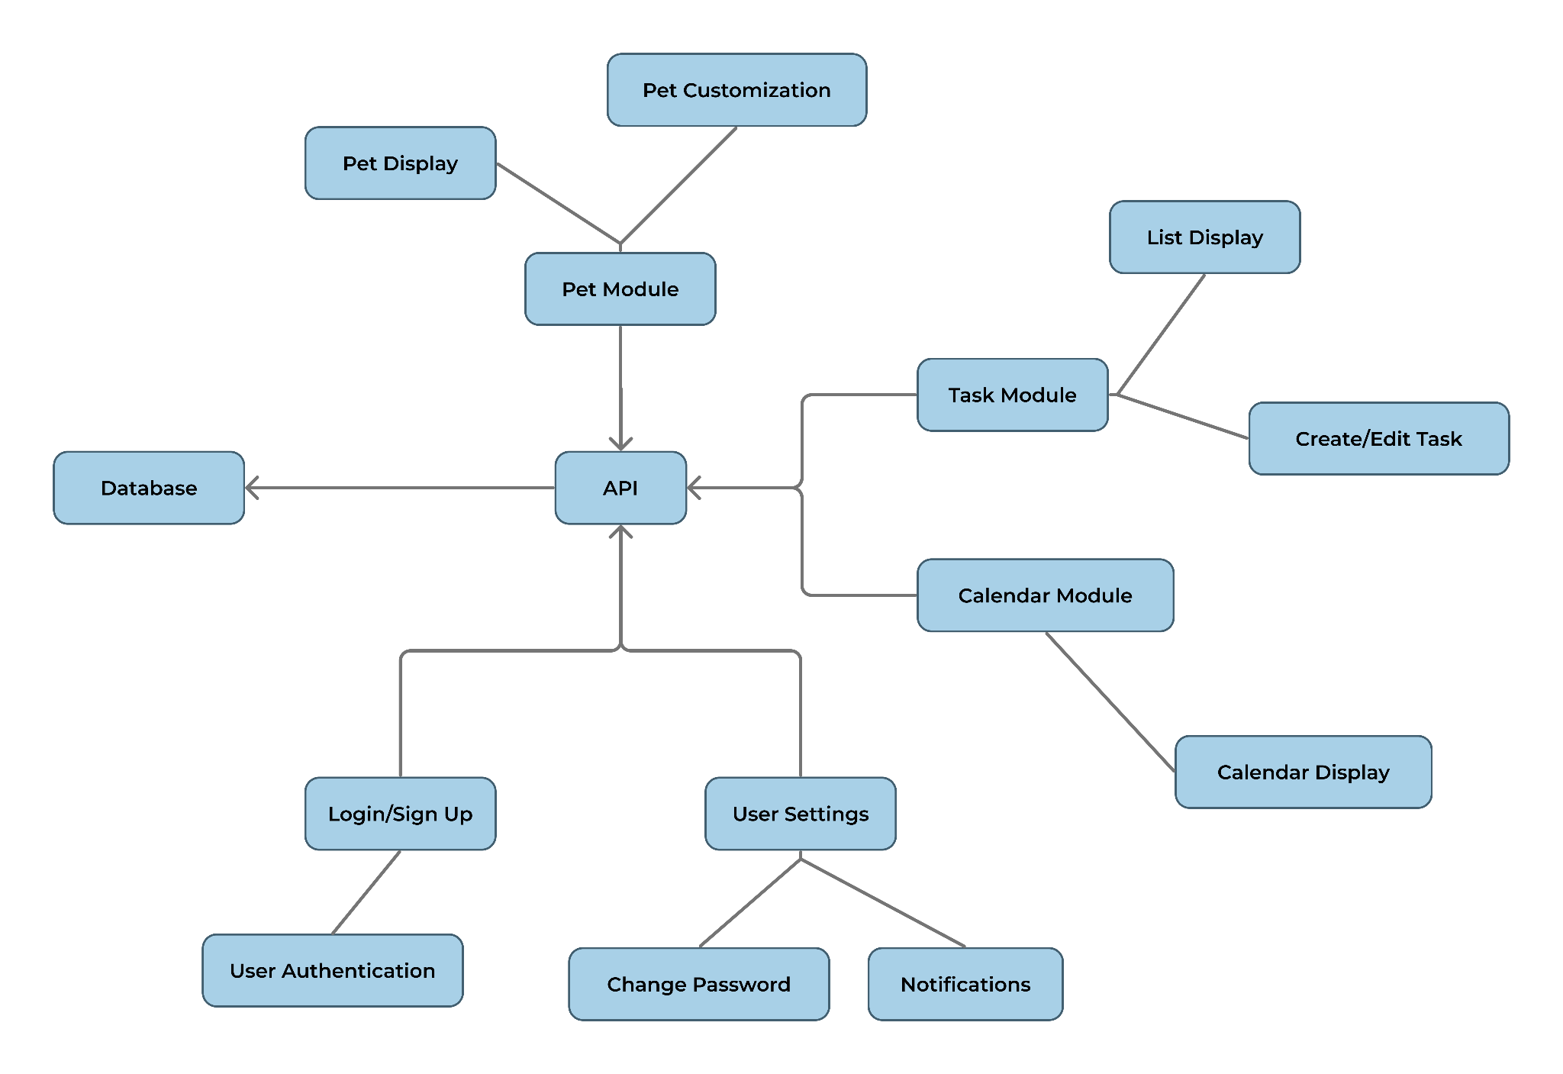
Component Diagram

Slide 5
Pet Module
Display Pet
Name
Age
Current health & status
Species & Color
Accessories
Customize Pet
Change name
Choose species
Choose color
Put on or remove accessories
Generate Pet
Upon pet creation, randomly chooses new pet’s species & color

Slide 6
Task Module & Calendar
Display Task
Name
Description
Due date
Completion status
Task List
List each task for current/selected day
Task Form
Create or edit a task
Options to set tasks to repeat
Calendar
Opens from task list
Toggle between month & week view
Task names displayed on due dates

Slide 7
User Accounts
Create an account with email
Saves pet data
Allows notifications
User Settings
Toggle notifications
Change password
Notifications
Email and push notification options
Task reminders
Pet health alerts

Slide 8
User-Interface Storyboard
The following slides will cover the User-Interface storyboard we had created, this will also work as our project’s design description.

Slide 9
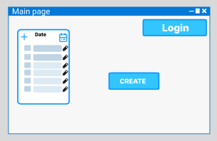
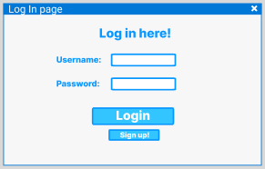
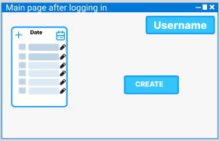
Main Page and Logging In

Slide 10
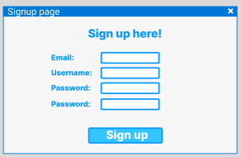
Main Page and Signing up

Slide 11
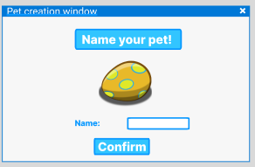
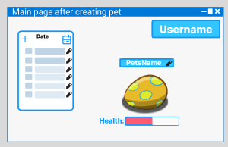
Pet Creation!

Slide 12
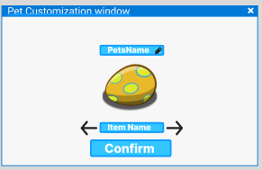
Pet Customization

Slide 13
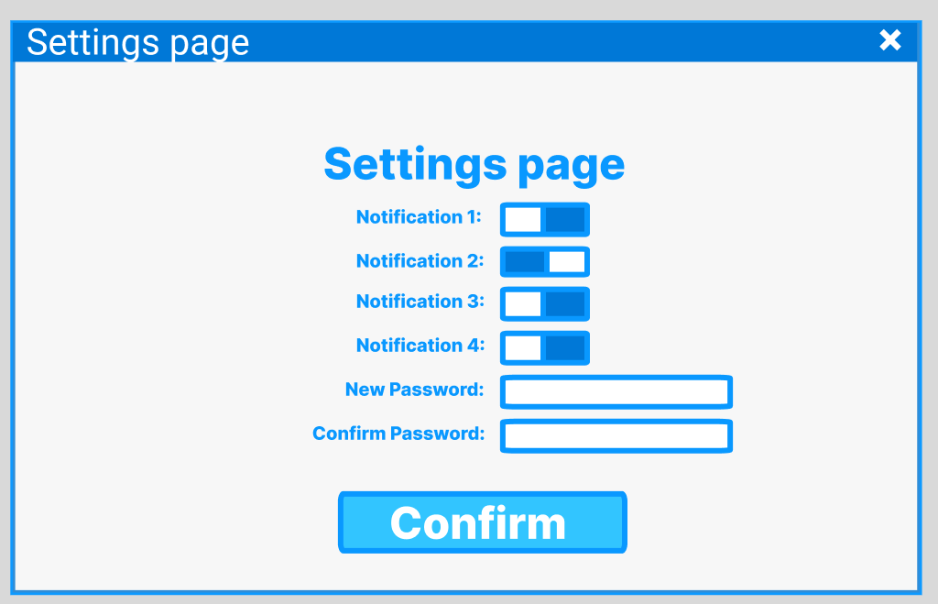
User settings

Slide 14
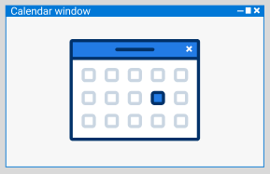
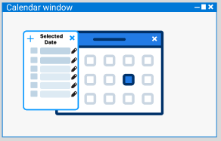
Calendar System!

Slide 15
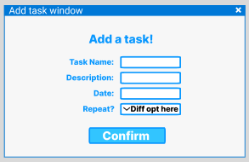
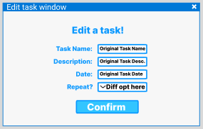
Adding/Editing Tasks

Slide 16
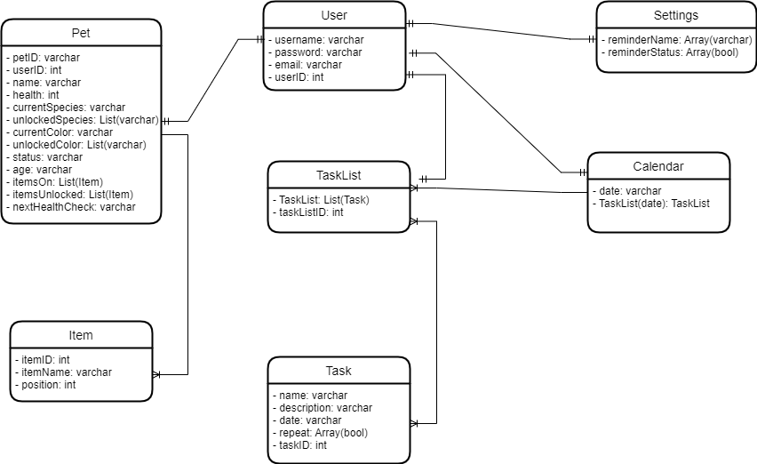
Storage Documentation

Slide 17
Thank You!
Any questions/comments?

